Slide 1
Sparse inverse covariance estimation with graphical lasso
Minzhe Zhang
Friedman, Jerome, Trevor Hastie, and Robert Tibshirani. "Sparse inverse covariance estimation with the graphical lasso." Biostatistics 9.3 (2008): 432-441.

Slide 2
Outline
Background
Approach
Result

Slide 3
What is a graph?
Vertices
Edges
Notes:
A graph is a structure describing a set of objects in which some pairs of the objects are in some sense related.
A graph contain two components, vertices or nodes and edges.
The objects correspond to mathematical abstractions called vertices (also called nodes or points) and each of the related pairs of vertices is called an edge (also called an arc or line).

Slide 4
How to infer graph structure?
Notes:
A more complex example would be the gene regulatory network in biology. We know in human there are around 20000 genes, and many genes have regulatory relationship, one gene is controlling the expression of another gene. In this a little complicated network, HES1 and HAP1 are regulated by a lot of other genes.
The structure of the network is very important for scientist to know how biological components are organized together, and how how different genes are clustered together to form a functional module. But usually the structure of a graph is hidden from us, and what we are interested is to infer the latent structure of graph from the obserale co-expession data.

Slide 5
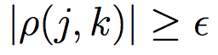
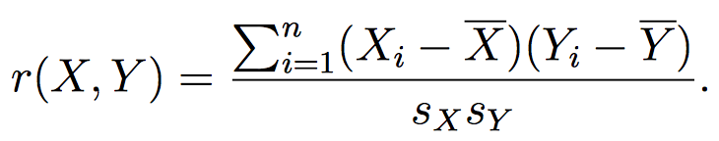
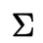
Marginal correlation
covariance matrix
Pearson Correlation
Kendall’s τ
Distance Correlation
The Bergsma-Dassios τ∗ Correlation
Notes:
One simplest idea is marginal correlation which we ignore all the other columns and simply look at the variable j and k, and calculate some statistical measure of association between them. One easiest way would be the Pearson correlation. and if we calculate the pairwise correlation, we get the covariane matrix. And if the value is above some certain Threshold， we draw a line between j and k.
We can also use some more robust and reliable measure like Kendall t , or Distance Correlation, but the basic idea is the same.

Slide 6
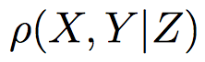
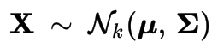
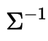
Partial correlation
A
B
C
Precision matrix
Challenge:
In high dimensional data, usually p >> n, accurate estimation of covariance matrix is unachievable.
But most network is sparse, so a lasso solution may help.
Notes:
One problem in marignal correlation is we only consider two variables, and ignore all other structure of the network, but actually it matters a lot. For example, in the graph, A has connection with both B and C, if A has high expression, then both B and C would have high probablity to have high expression also. So from the marginal correlation, B and C will have a high correlation, and in fact, B and C are not conncected.
The partial correlation between X and Y , given Z, is a measure of association between X and Y after removing the effect of Z. Mathmatically, if ... then the inverse covariane matrix also called precision matrix describe the partial correlation. So if two node has partial correlation zero, that means they are conditionally independent. So our job now becomes to estimate the inverse covariance matrix.
The problem is...
But luckily, ..., which means majority pair of nodes are not connected, their partial correlation is zero.

Slide 7
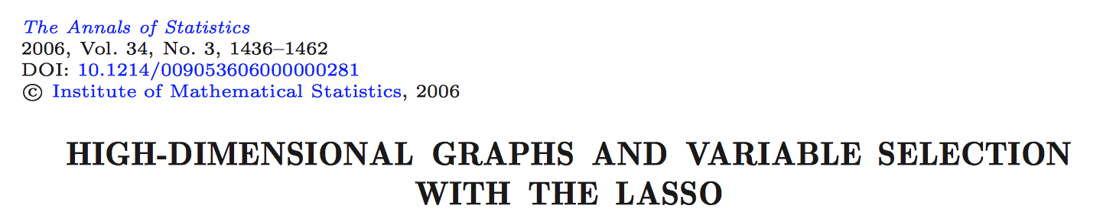
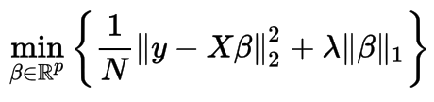
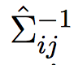
Variable selection with lasso
Y
X
is estimated to be nonzero if either the estimated coefficient of variable i on j or the estimated coefficient of variable j on i is nonzero.
Notes:
To address this question, in 2006, Meinshausen and Buhlmann published a paper “”. In this paper, they take a simple approach to this problem, they estimate the sparse grahical model by fitting a lasso model to each variable using all the others as predictors.

Slide 8
Graphical Lasso
Simple and Faster
More general, bridge the “conceptual gap” between the previous method and the exact problem.
Notes:
In this paper, the authors claim that their approach is extremely simple and much faster than competing approach.

Slide 9
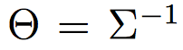
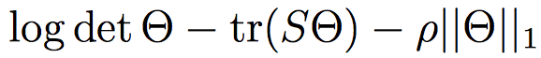
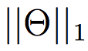
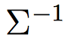
Method
maximize the penalized log-likelihood over nonnegative definite matrices
(1)
S is empirical covariance matrix
tr is the trace
is the L1 norm – sum of absolute values of the element
Notes:
S: emprical covariance matrix

Slide 10
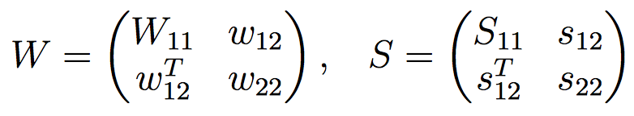
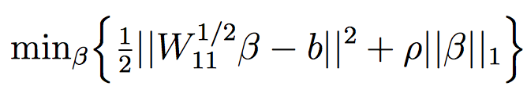
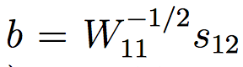
Let W be the estimate of (rather than )
Partitioning W and S
(2)
(3)
(4)
Banerjee, Onureena, Laurent El Ghaoui, and Alexandre d’Aspremont. "Model selection through sparse maximum likelihood estimation for multivariate gaussian or binary data." Journal of Machine learning research 9.Mar (2008): 485-516.
Notes:
By partioning W and S, they show that the solution fow w12 satistify the following equation.

Slide 11
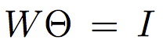
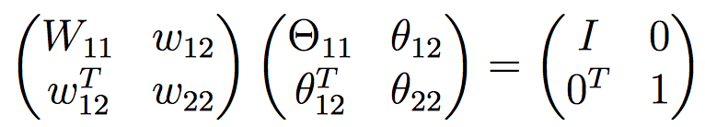
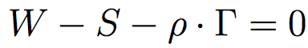
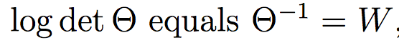
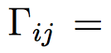
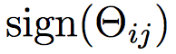
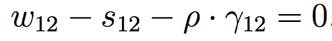
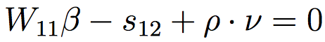
given
(5)
Now the sub-gradient equation for maximization of the log-likelihood (1) can be transformed into
(6)
The upper right block of (6) is then
(7)
The subgradient equation from (4) works out to be
(8)

Slide 12
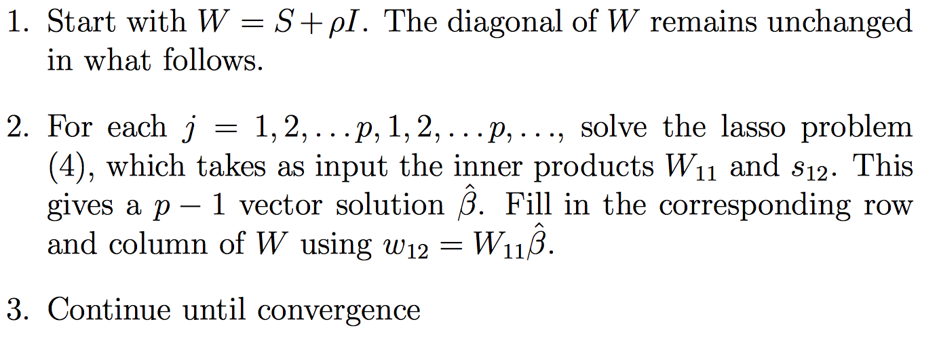
Graphical lasso algorithm

Slide 13
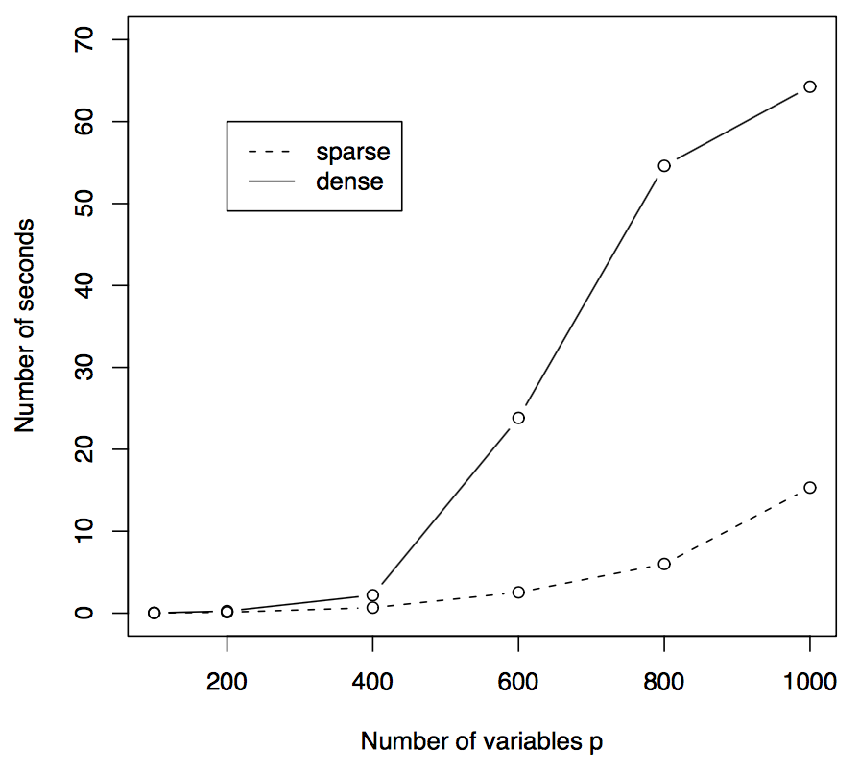
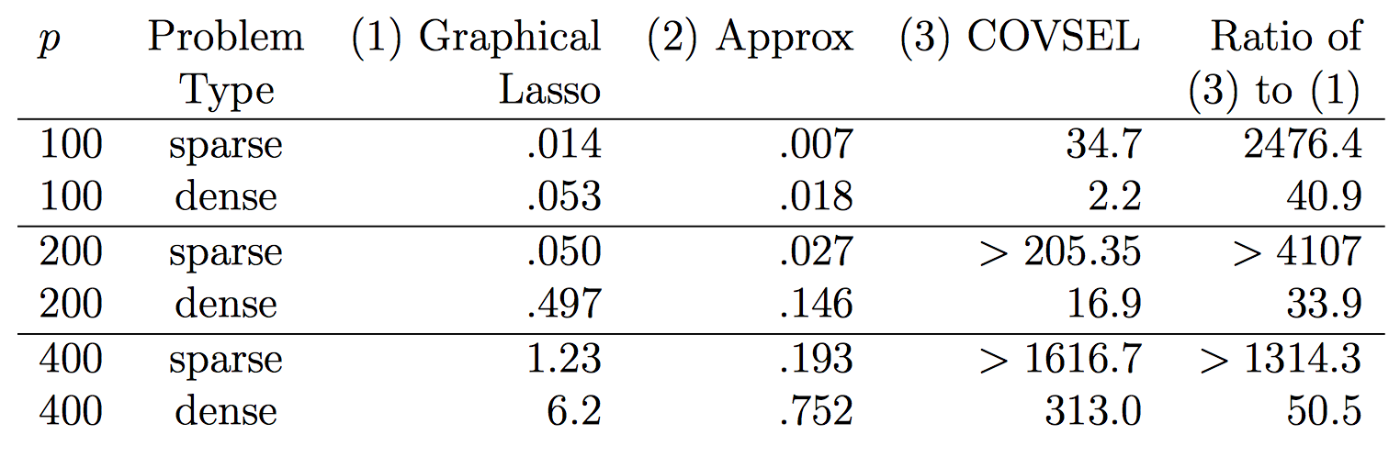
Timing

Slide 14
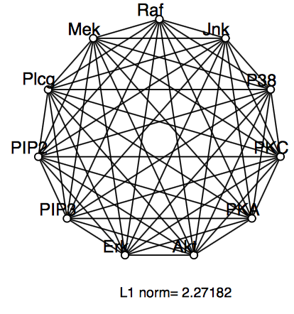
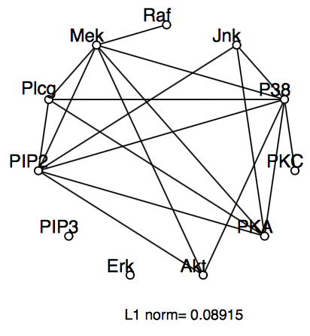
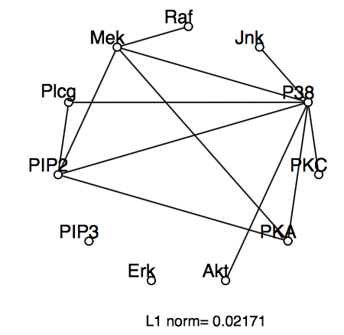
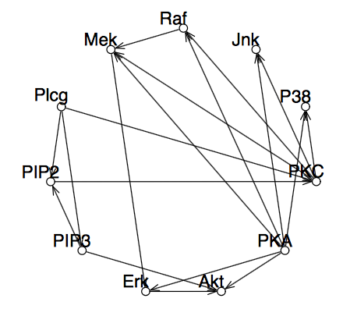
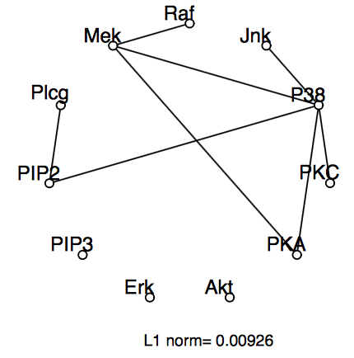
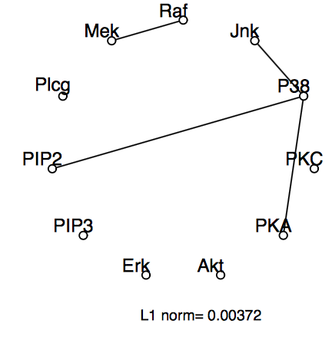
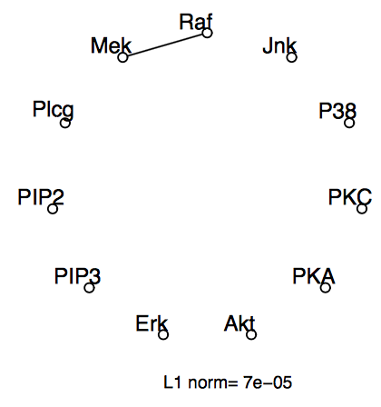
Cell signaling data

Slide 15
Thanks!

